Slide 1


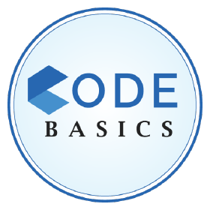
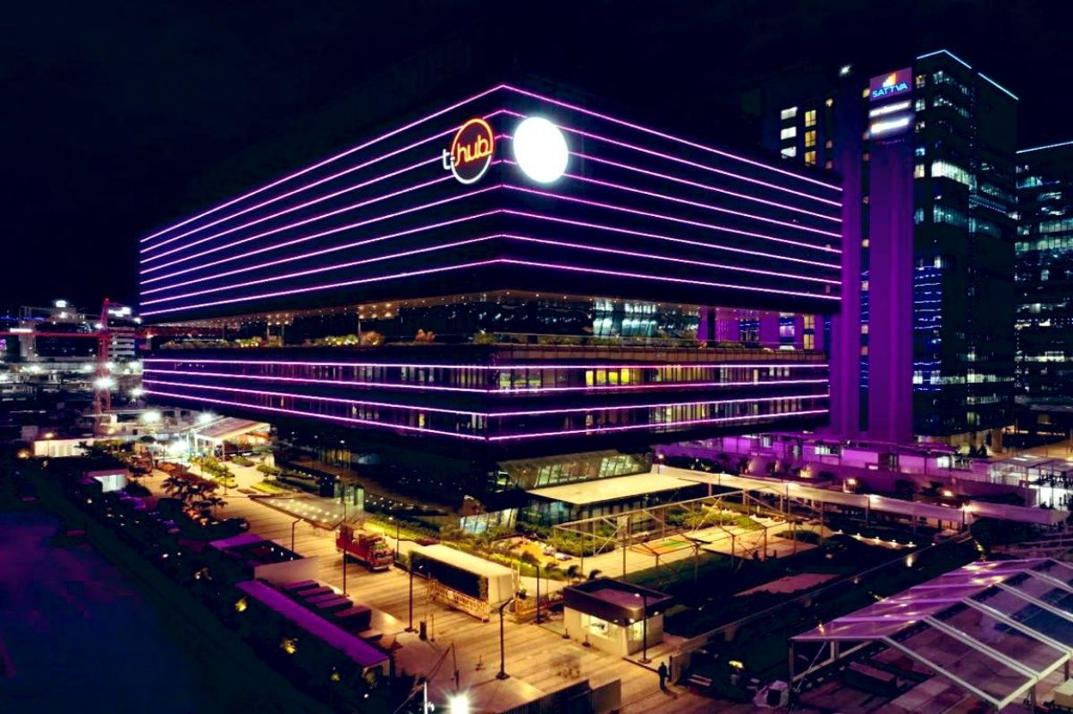
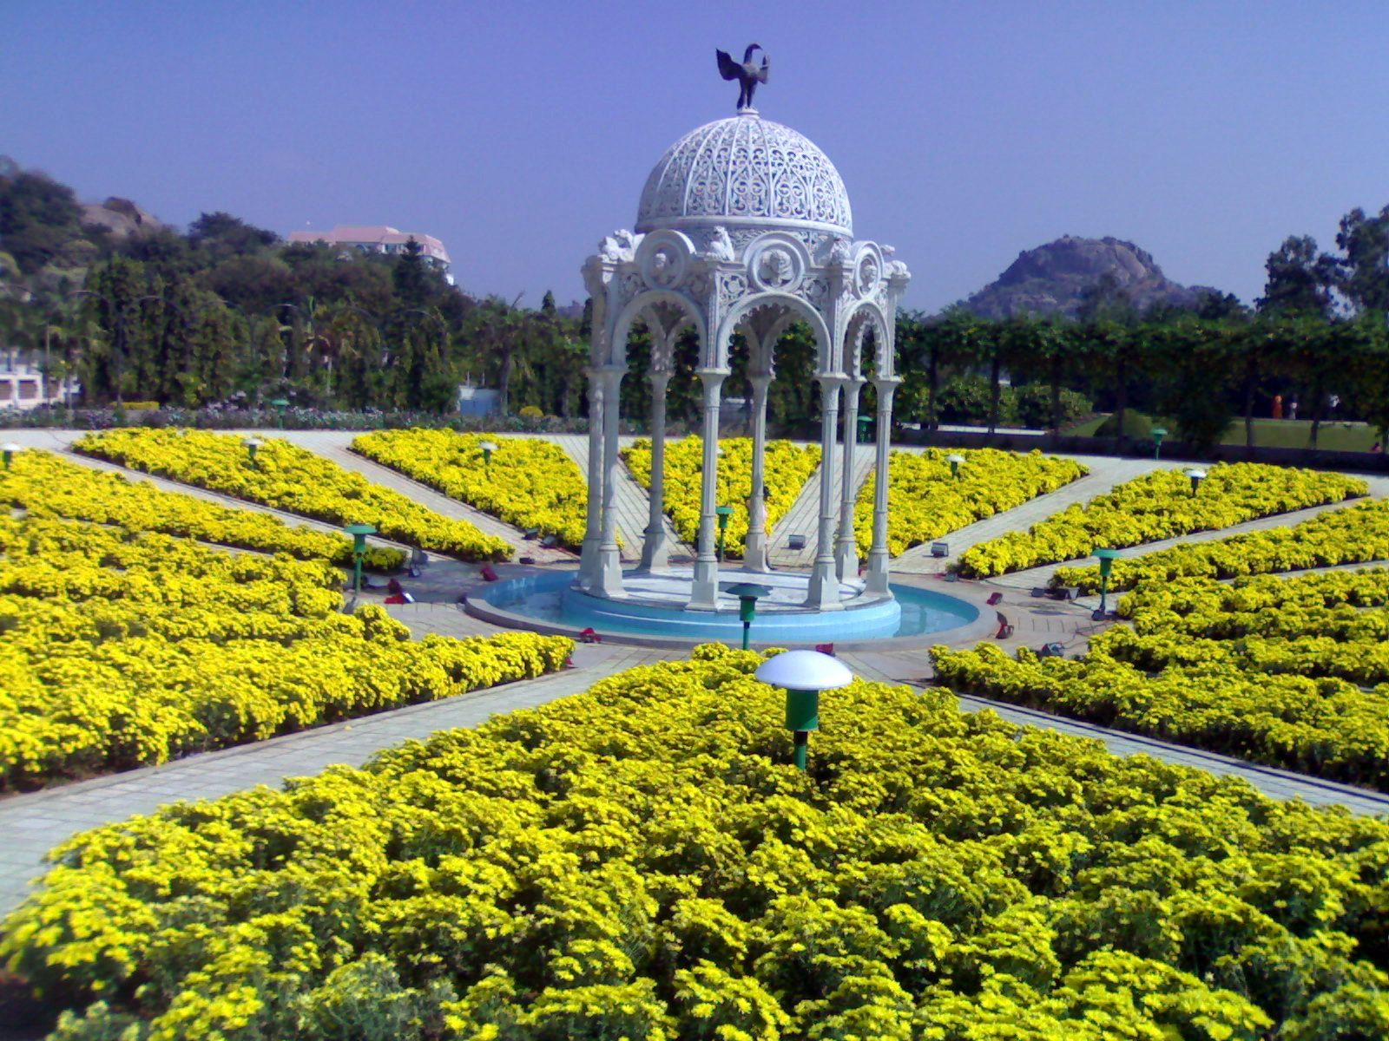
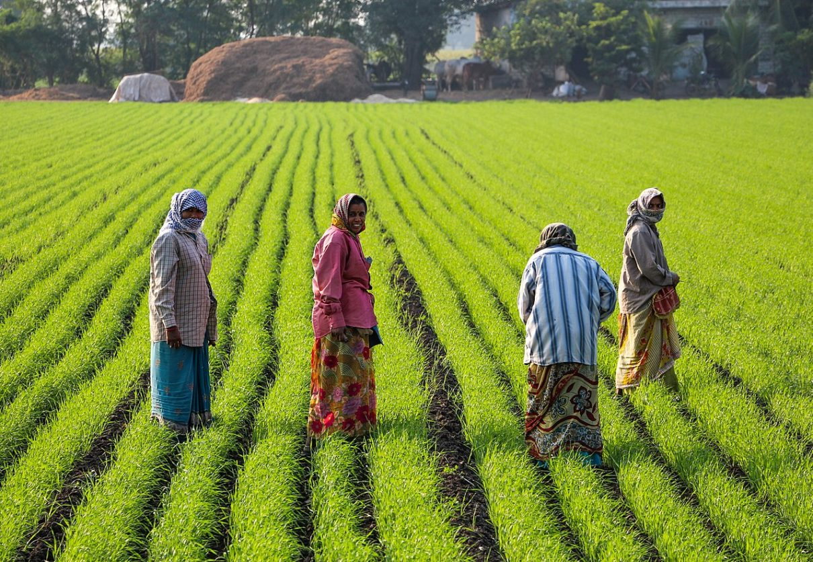
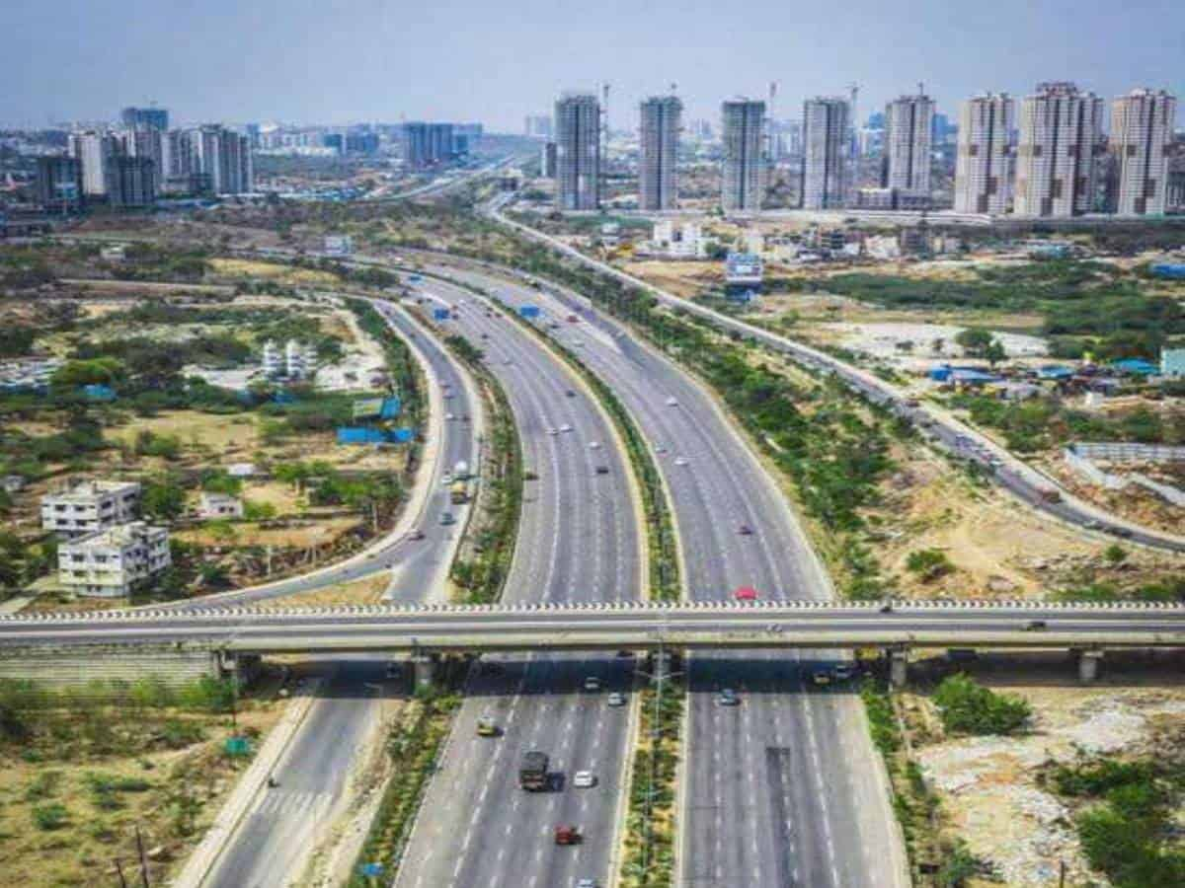
TELENGANA GROWTH ANALYSIS
Report by:- Harish Gowda B K harishgowdabk98@gmail.com

Slide 2
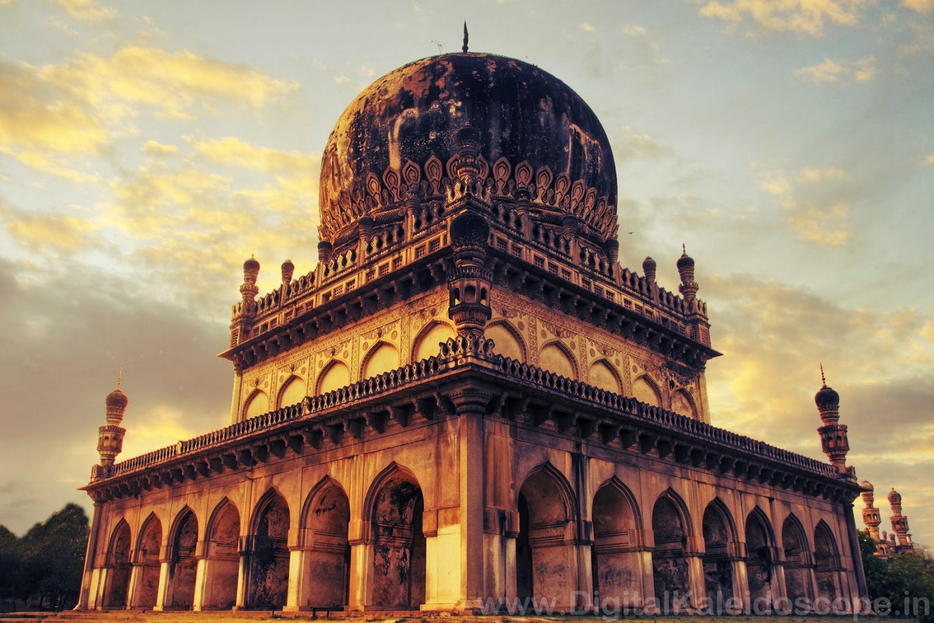
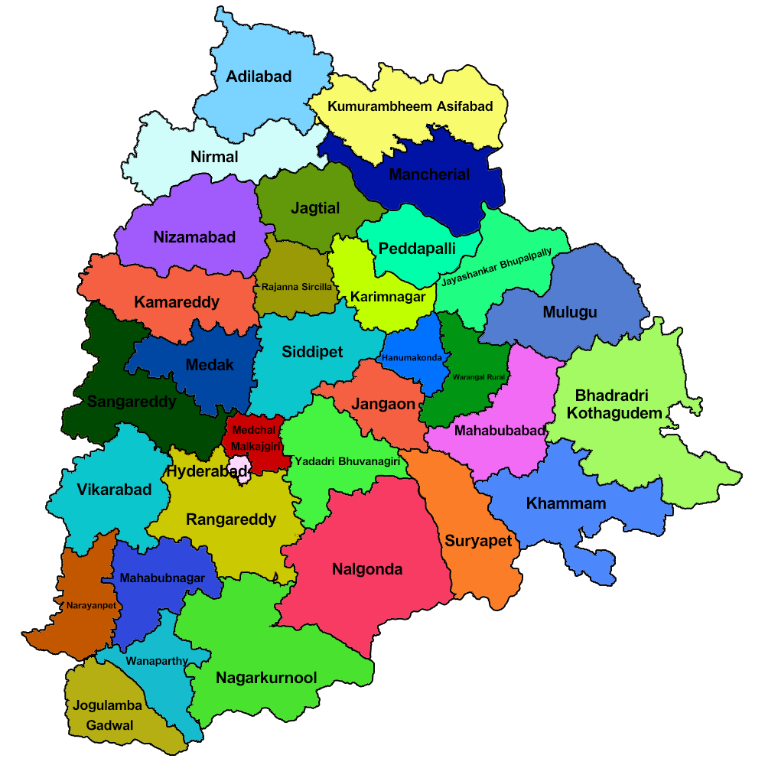

INTRODUCTION
Telangana, located in southern India, is the country's youngest state, formed in 2014. Known for its rich cultural heritage and historical significance, it has rapidly evolved into a dynamic economic powerhouse. Hyderabad, its capital city, is a major global IT and business hub, often referred to as "Cyberabad”. Telangana boasts a diverse landscape, with a mix of urban vibrancy and rural charm, making it a region of great promise and opportunity.

Slide 3
Project Objectives
• Explore Stamp Registration, Transportation and Ts-Ipass Datasets. Understand their attributes, categories and time period. • Analyze trends and patterns within each department. • Identify growth opportunities and areas needing attention. • Find correlation among these departments and report the overall growth of the state through insights and relevant visuals such as shape maps.

Slide 4

STAMP REGESTRATION ANALYSIS
Stamp registration analysis refers to the process of examining and evaluating data related to the registration of legal documents, such as property deeds, contracts, and agreements, to extract valuable insights. This analysis involves assessing trends, patterns, and financial information associated with these registrations.
Data analysis of stamp revenue generation can significantly contribute to the overall development of a state by: Resource Allocation Policy Formulation Fraud Detection Economic Planning

Slide 5
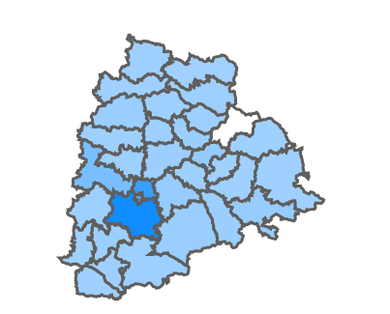
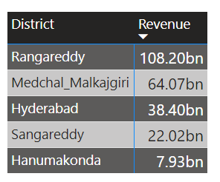
How does the revenue generated from document registration vary across districts in Telangana?
It's clear from the map that the districts surrounding Hyderabad, forming the Hyderabad Metropolitan Region, generate higher revenues. This is due to the region's well-developed infrastructure, a large skilled workforce, and government policies promoting industrial development and investment attraction, resulting in increased state revenue.
Top 5 Districts

Slide 6
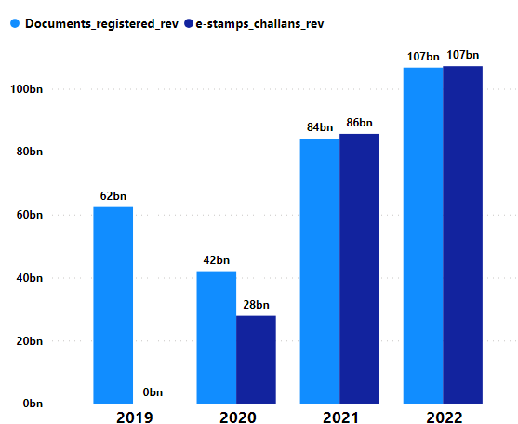
How does the revenue generated from document registration compare to the revenue generated from e-stamp challans across districts?
The introduction of e-Stamp challans in 2020 has coincided with a noticeable decline in revenue generated from document registration. This trend strongly implies a growing preference among individuals for utilizing e-Stamp challans as their preferred method for paying stamp duty Recommendations:- → Make it easier to purchase e-stamps: E-stamps should be available for purchase through a variety of channels, including government websites, mobile apps, and banks. This will make it easier for people to purchase e-stamps, regardless of their location or access to technology.

Slide 7
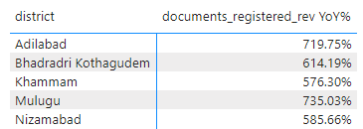
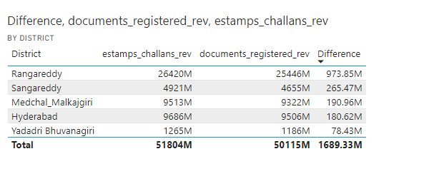
List down the top 5 districts that showed the highest document registration revenue growth between FY 2019 and 2022.
List down the top 5 districts where e-stamps revenue contributes significantly more to the revenue than the documents in FY 2022?

Slide 8
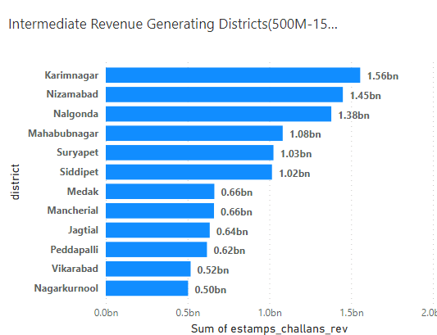
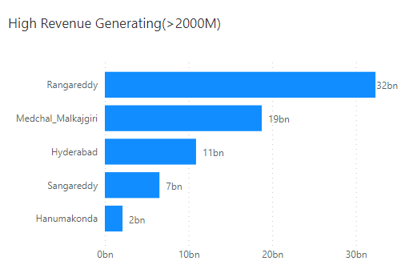
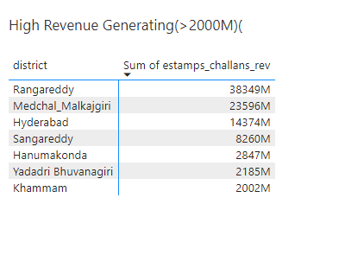
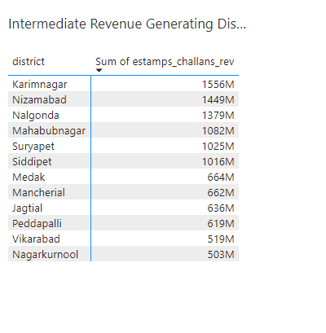
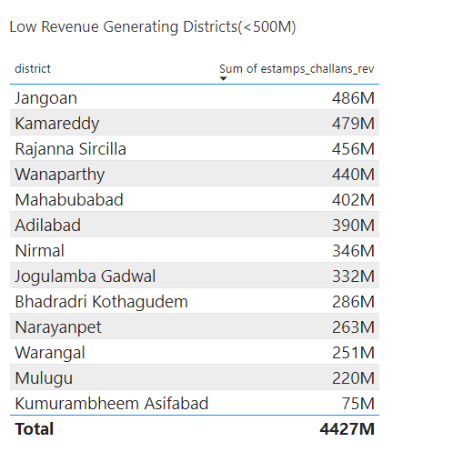
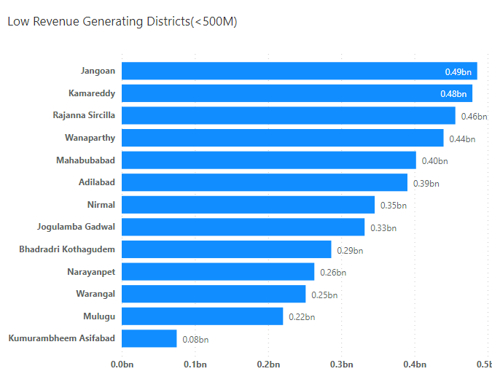
Categorize districts into three segments based on their stamp registration revenue generation during the fiscal year 2021 to 2022.
Low Revenue(<0.5B)
High Revenue(>2B)
Intermediate Revenue(1.5B-2B)

Slide 9
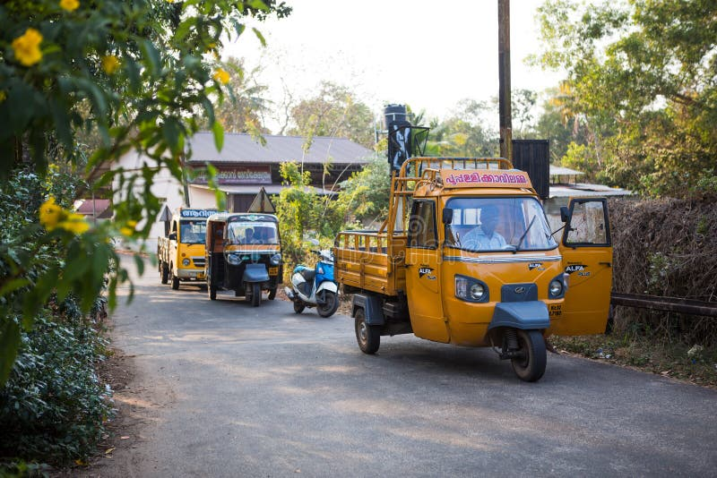
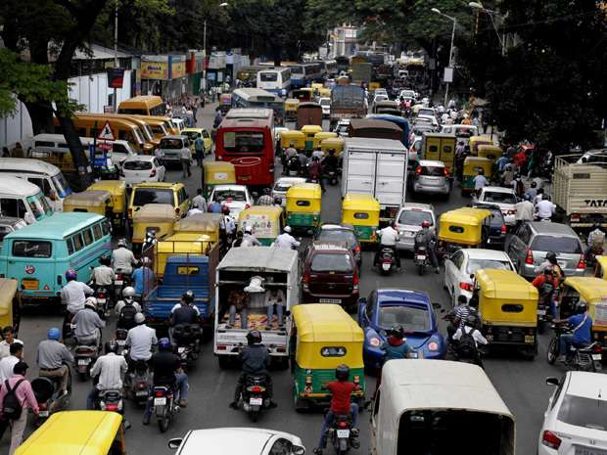
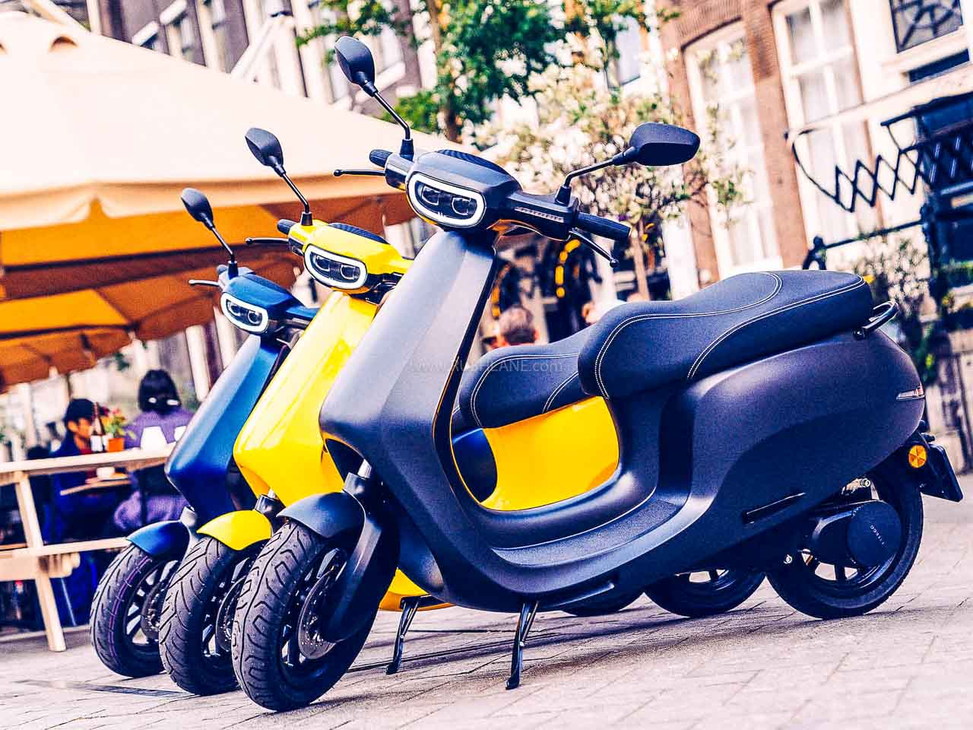
TRANSPORTATION ANALYSIS
It involves analyzing data for understanding the different composition of type of vehicles and helps shape transportation policies, like incentives for eco-friendly vehicles or regulations to manage specific vehicle categories. It informs infrastructure decisions, such as road size, parking facilities, and charging stations for electric vehicles, based on vehicle composition.

Slide 10
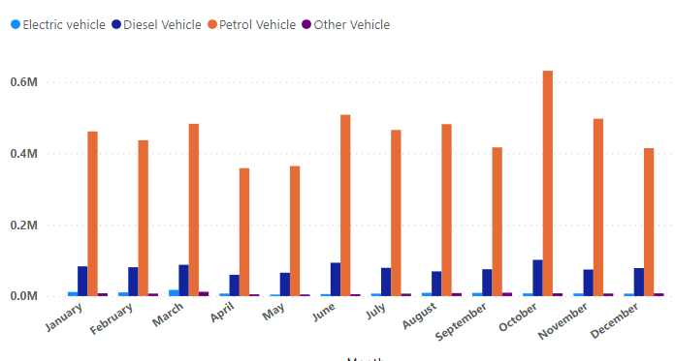
Are there any months or seasons that consistently show higher or lower sales rate, and if yes, what could be the driving factors?
There exists a clear correlation between vehicle sales and specific months or seasons. Notably, vehicle sales exhibit a consistent upsurge during the summer months due to :- → End of the current fiscal year →End of the model deals →Favourable weather conditionsas opposed to the relatively subdued winter months. Lower sales months:- April,May,Nov&Dec due to :- →post financial planning →vacation season →new model introduction next year
.

Slide 11
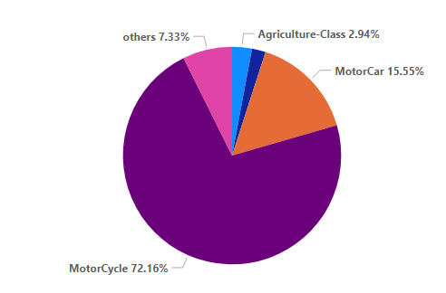
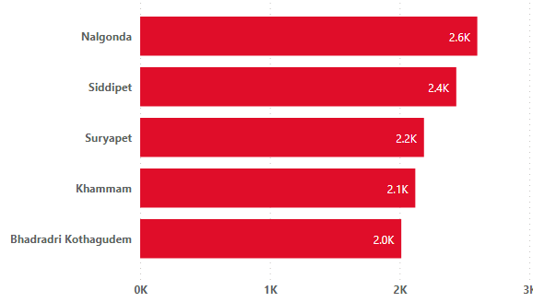
How does the distribution of vehicles vary by vehicle class (MotorCycle, MotorCar, AutoRickshaw, Agriculture) across different districts? Are there any districts with a predominant preference for a specific vehicle class? Consider FY 2022 for analysis.
Motorcycles: Motorcycles are the most popular vehicle class in all districts, accounting for over 50% of total vehicle sales in most districts. Agricultural vehicles: Agricultural vehicles are more popular in rural districts, accounting for up to 10% of total vehicle sales in some districts.
AGRICULTURE VEHICLES

Slide 12
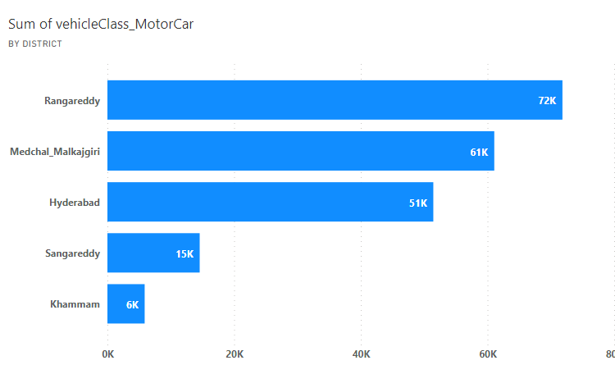
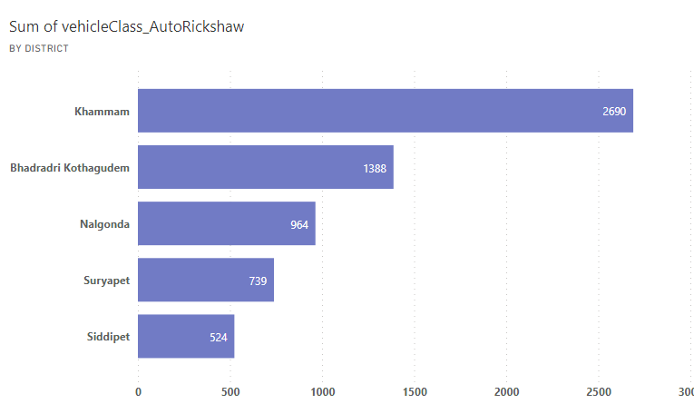
MOTOR CARS
Motorcars: Motorcars are the second most popular vehicle class in most districts, accounting for between 20% and 30% of total vehicle sales.
AUTORICKSHAWS
Autorickshaws: Autorickshaws are more popular in urban districts, accounting for up to 10% of total vehicle sales in some districts.
• There are no districts with a predominant preference for a specific vehicle class. However, there are some districts where certain vehicle classes are more popular than others. For example, the districts of Ranga Reddy, Medchal, and Hyderabad have a higher proportion of motorcars than other districts. The districts of Adilabad, Nirmal, and Jogulamba Gadwal have a higher proportion of agricultural vehicles than other districts and autorickshaws are predominant in urban cities

Slide 13
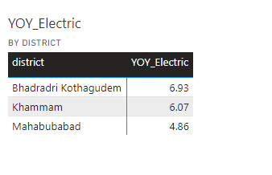
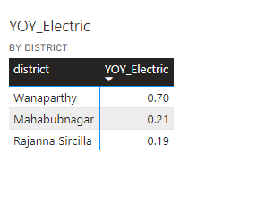
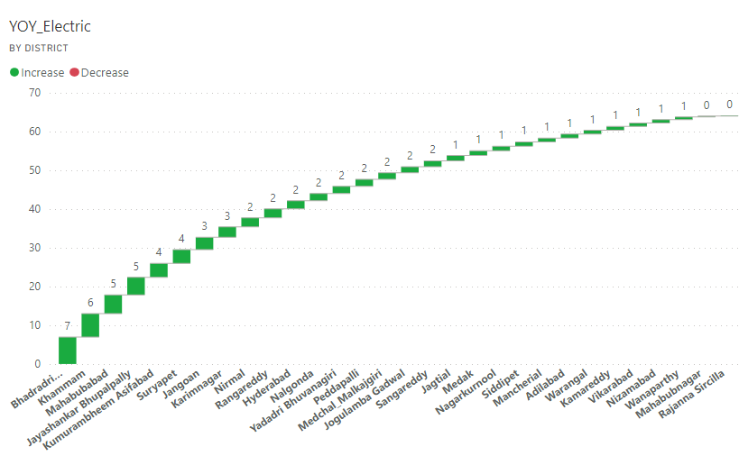
List down the top 3 and bottom 3 districts that have shown the highest and lowest vehicle sales growth during FY 2022 compared to FY 2021? (Consider and compare categories: Petrol, Diesel and Electric)
Top 3 Districts
YoY Electric Vehicles Sales
Bottom 3 Districts

Slide 14
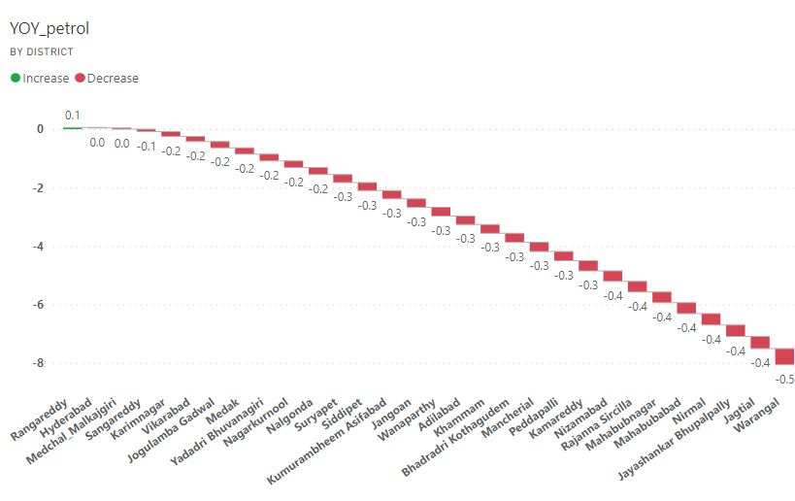
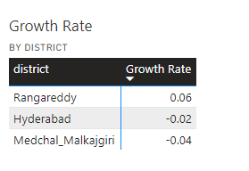
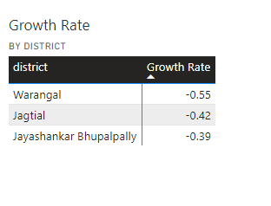
List down the top 3 and bottom 3 districts that have shown the highest and lowest vehicle sales growth during FY 2022 compared to FY 2021? (Consider and compare categories: Petrol, Diesel and Electric)
YoY Petrol Vehicles Sales
Top 3 Districts
Bottom 3 Districts

Slide 15
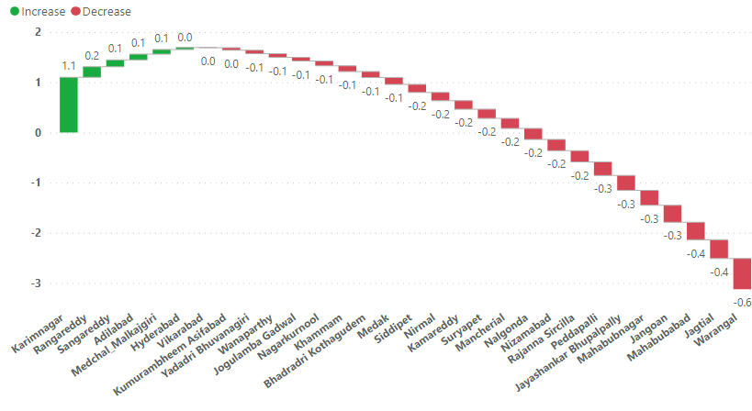
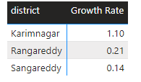
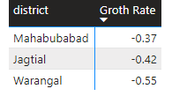
List down the top 3 and bottom 3 districts that have shown the highest and lowest vehicle sales growth during FY 2022 compared to FY 2021? (Consider and compare categories: Petrol, Diesel and Electric)
YoY Diesel Vehicles Sales
Top 3 Districts
Bottom 3 Districts

Slide 16
TS-IPASS Analysis
Ts-Ipass analysis is the process of analyzing data from the Ts-Ipass portal to identify trends and patterns in investments in Telangana. The Ts-Ipass portal is a single-window clearance system for investors in Telangana.
It can be highly beneficial for the state government of Telangana in several ways:
Economic Growth: It can provide insights into the performance of industries and businesses, helping the government identify growth sectors, assess job 2.Policy Refinement: inform policy decisions, enabling the government to tailor incentives, regulations. 3.Compliance Monitoring: The records can be used to monitor compliance with regulatory requirements.
4.Revenue Generation: By tracking project approvals and investments, the state can assess the impact on tax revenue, aiding in budget planning and fiscal management.
5.Employment Opportunities: It assists in understanding the employment landscape, facilitating workforce development programs and aligning education and training with industry needs, ultimately fostering overall economic development in Telangana.

Slide 17
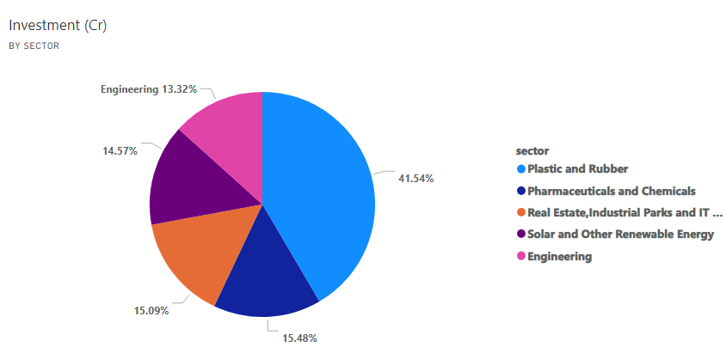
List down the top 5 sectors that have witnessed the most significant investments in FY 2022.
These sectors have attracted substantial investment due to a number of factors, including the Telangana government's focus on promoting industrial development and attracting foreign investment. The state government has also offered a number of incentives to investors, such as tax breaks and subsidies. The investment in these sectors is expected to create jobs and boost the state's economy. It will also help to make Telangana a more attractive destination for businesses and investors.
Investment in crores in FY-2022

Slide 18
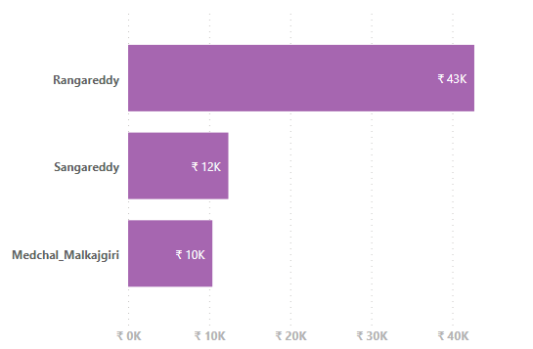
List down the top 3 districts that have attracted the most significant sector investments during FY 2019 to 2022? What factors could have led to the substantial investments in these particular districts?
These districts have attracted substantial investments due to a number of factors, → Location: Rangareddy, Sangareddy, and Medchal-Malkajgiri are all located in the Hyderabad Metropolitan Region (HMR), which is one of the fastest-growing metropolitan regions in India. → Infrastructure: The HMR has a well-developed infrastructure, including roads, railways, and airports. This makes it an attractive destination for businesses and investors. →Government policies: The Telangana government has implemented a number of policies to promote industrial development and attract investment. These policies include tax breaks, subsidies, and single-window clearance for businesses. →Skilled workforce: The HMR has a large pool of skilled and educated workers. This makes it an attractive destination for businesses that require a skilled workforce.
Sum of Investment in crores

Slide 19
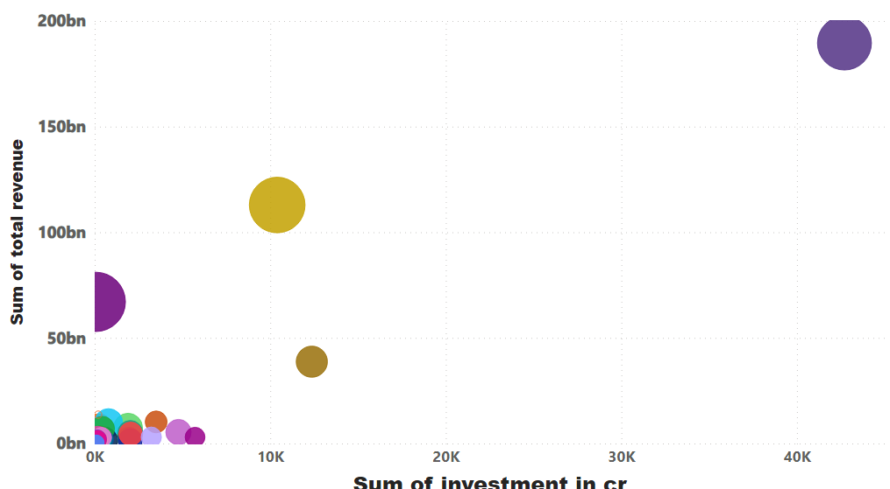
Is there any relationship between district investments, vehicles sales and stamps revenue within the same district between FY 2021 and 2022?
There is no clear relationship between district investments, vehicle sales, and stamps revenue within the same district between FY 2021 and 2022. the districts with the highest investment (Ranga Reddy, Sanga Reddy, and MedchalMalkajgiri) do not necessarily have the highest vehicle sales or stamps revenue. There are a number of possible explanations for this lack of correlation. →One possibility is that the investment is in sectors that do not generate a lot of vehicle sales or stamps revenue, such as infrastructure or heavy industry. →Another possibility is that the investment is in sectors that are new to the district, and it will take some time for the investment to have an impact on vehicle sales and stamps revenue.

Slide 20
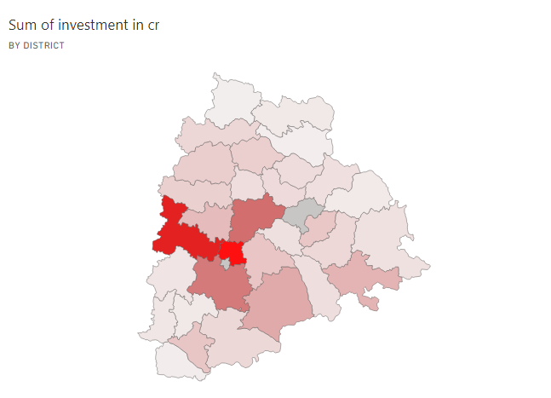
Are there any particular sectors that have shown substantial investment in multiple districts between FY 2021 and 2022?
There are some particular sectors that have shown substantial investment in multiple districts between FY 2021 and 2022 in Telangana, → Food Processing: This sector has attracted significant investment in districts such as Rangareddy, Medchal-Malkajgiri, Hyderabad, and Warangal but has substantial investments in other districts too →Pharmaceuticals and Chemicals: This sector has attracted significant investment in districts such as Rangareddy, Medchal-Malkajgiri, Sangareddy, and Hyderabad. →Manufacturing: This sector has attracted significant investment in districts such as Rangareddy, Medchal-Malkajgiri, Hyderabad, and Mahabubnagar. In addition to the above sectors, the Telangana government is also focusing on developing specific industries in different districts. For example, the Rangareddy district is home to the Hyderabad Pharma City, which is one of the largest pharmaceutical clusters in the world. The Sangareddy district is home to the Telangana Aerospace and Defense Park, which is one of the largest aerospace and defense parks in India.

Slide 21
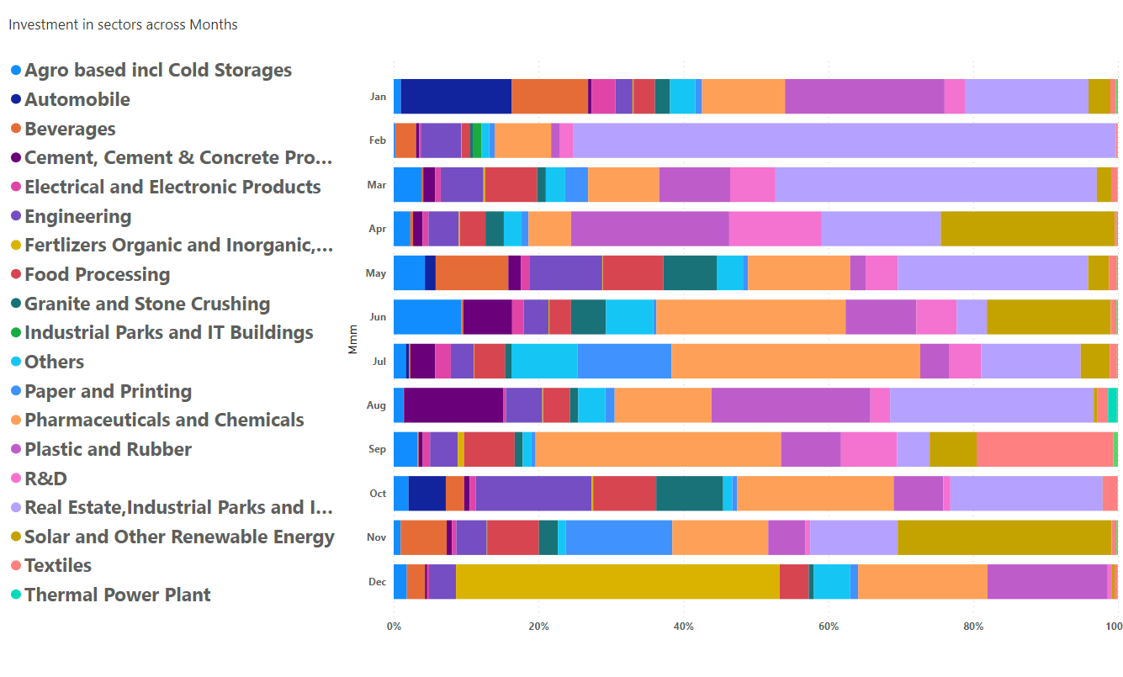
Can we identify any seasonal patterns or cyclicality in the investment trends for specific sectors? Do certain sectors experience higher investments during particular months
there are a few observations that can be made: → Investment in the pharmaceuticals and chemicals sector is relatively consistent throughout the year. This is likely because the pharmaceuticals and chemicals sector is a defensive sector, meaning that it is less affected by economic downturns. → Investment in the real estate industrial sector tends to be higher in the first quarter of the year. This is likely because businesses are more likely to invest in new office space and manufacturing facilities at the beginning of the year. → Investment in the solar and other renewables sector tends to be higher in the second and third quarters of the year. This is likely because the weather is more favorable for solar energy production during these months. →Investment In the agriculture sector tends to be higher during the monsson period which is favourable for crop growth

Slide 22
What are the top 5 districts to buy commercial properties in Telangana? Justify your answer.
the top 5 districts for commercial properties in Telangana, along with reasons: → Hyderabad: it is the capital and largest city of Telangana. It is a major center for IT, pharmaceuticals, and manufacturing.
→ Rangareddy: Rangareddy is a district that surrounds Hyderabad. It is home to several major IT and manufacturing companies, as well as the Hyderabad International Airport. → Medchal: Medchal is a district that is adjacent to Rangareddy. It is home to several IT and manufacturing companies, as well as the Hyderabad Pharma City. → Sangareddy: Sangareddy is a district that is north of Hyderabad. It is home to several IT and manufacturing companies, as well as the Telangana Aerospace and Defence Park. → Medak: Medak is a district that is northwest of Hyderabad. It is home to several IT and manufacturing companies, as well as the Singareni Collieries Company Limited. In addition to the factors mentioned above, the top 5 districts for commercial properties in Telangana also have the following advantages: → Good connectivity: All of these districts are well-connected to Hyderabad and other major cities in India by road, rail, and air. → Availability of land: There is a large availability of land for commercial development in all of these districts. →Favorable government policies: The Telangana government offers a number of incentives to businesses that invest in the state, such as tax breaks and subsidies.

Slide 23
Provide top 5 Insights & 5 recommendations to Telangana government for sustained growth in the next 5 years based on your analysis
INSIGHTS:- → Strong economic growth:- Telangana has recorded strong economic growth in recent years, with a GSDP growth rate of 16.3% in 2022-23.
→ Diverse economy:-Telangana has a diversified economy, with sectors such as IT, pharmaceuticals, manufacturing, and agriculture all playing important roles. → Favorable investment climate:- Telangana has created a favorable investment climate through its ease of doing business reforms and other initiatives. → Strategic Govt:-Telangana has a government that is committed to economic development and has implemented a number of policies and initiatives to attract investment and promote growth. RECOMENDATIONS → Continue to invest in infrastructure: Telangana should continue to invest in infrastructure, such as roads, railways, and airports. This will improve connectivity and make it easier for businesses to operate in the state. → Continue Focus on high-value sectors: Telangana should focus on attracting investment in highvalue sectors, such as IT, pharmaceuticals, and manufacturing. These sectors offer good jobs and wages, and can help to drive economic growth more in other districts too →Invest in research and development: Telangana should invest in research and development to promote innovation and create new products and services. This will help to make the state's economy more competitive and resilient. → Continue Invest in education and training: Telangana should continue to invest in education and training to ensure that its workforce has the skills needed to meet the demands of the growing economy.

Slide 24
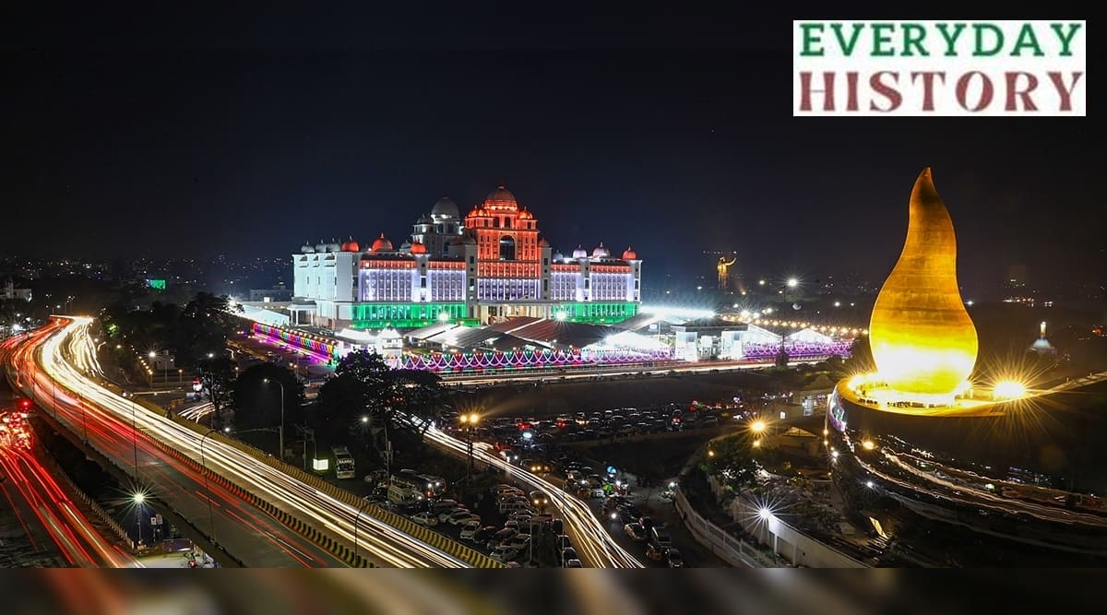
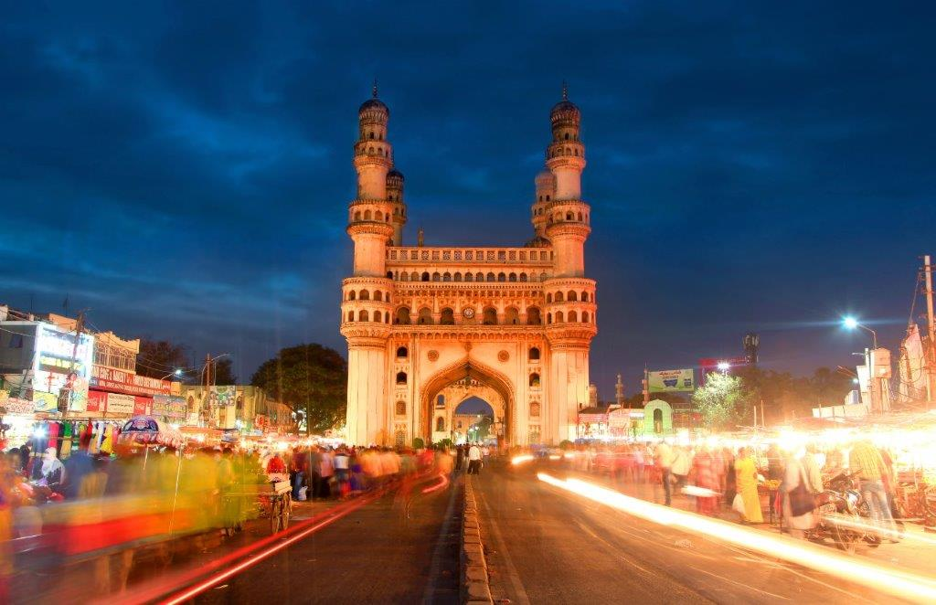
Thank you

